Slide 1
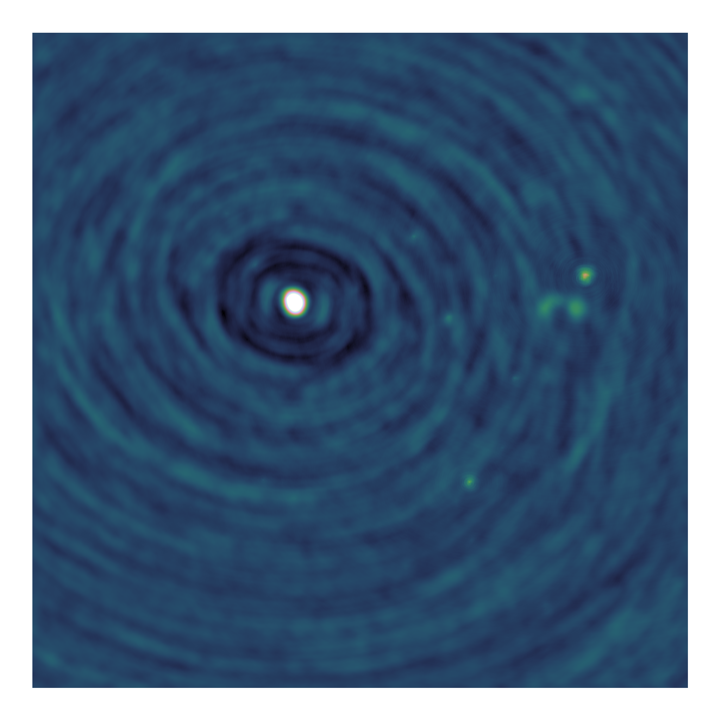
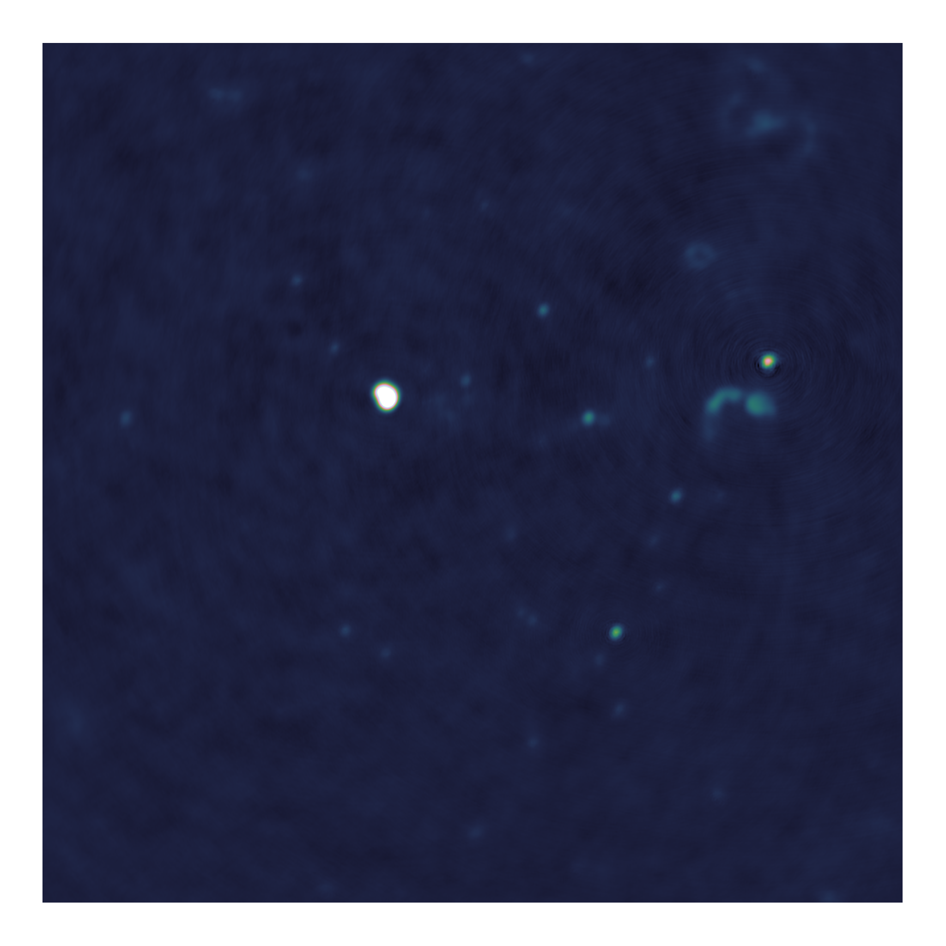
Towards distributed image reconstruction

Slide 2
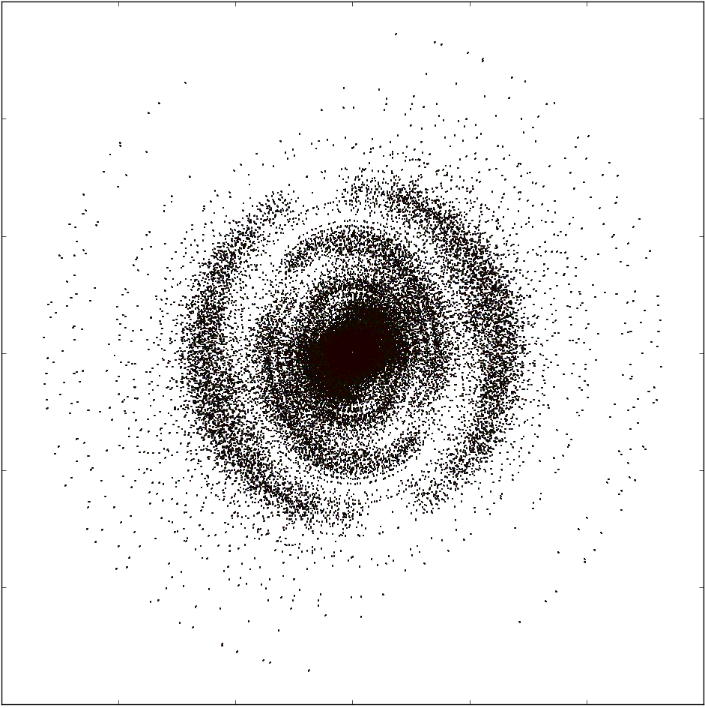
Measurements of the Interferometer
Measurements
Dirty Image
Reconstruction

Slide 3
Deconvolution
Major cycle, deconvolution

Slide 4
Major/Minor cycle
Major Cycle, Visibilities to Image
Minor Cycle, deconvolution

Slide 5
Minor Cycle algorithm
CLEAN
Parallel coordinate descent

Slide 6
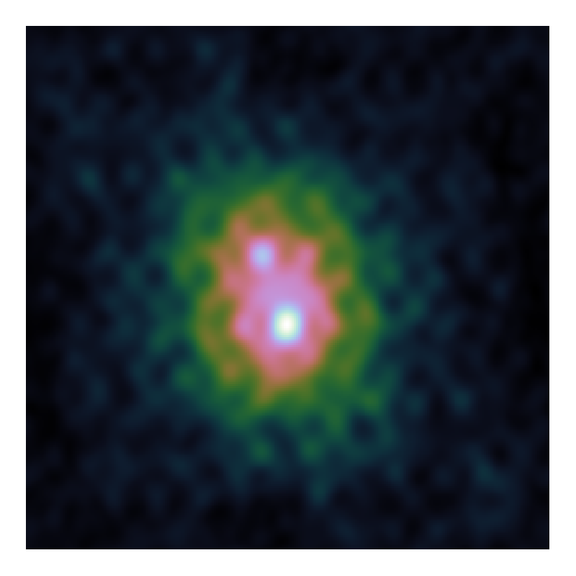
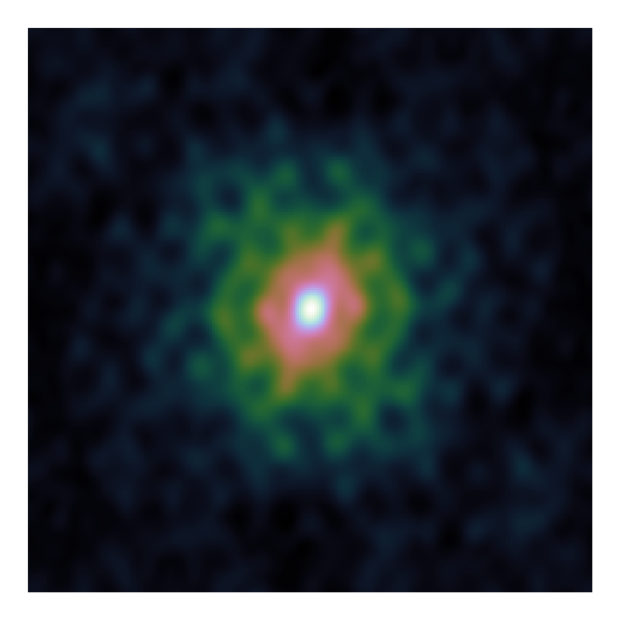
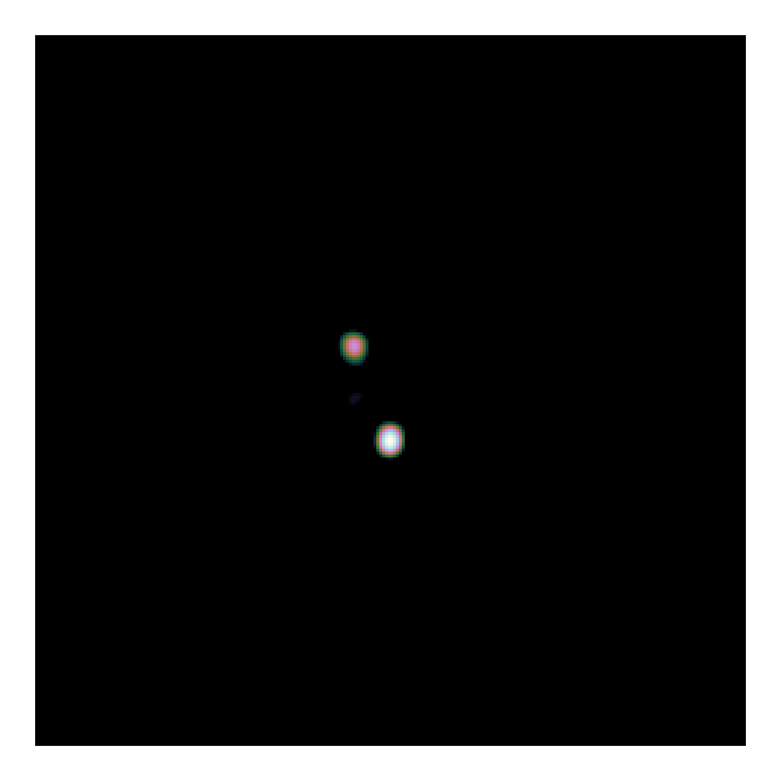
CLEAN

Slide 7
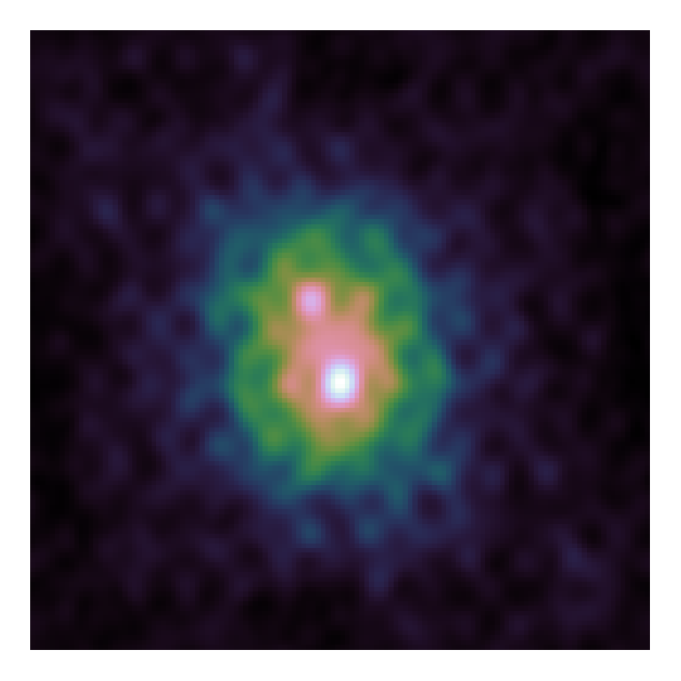

CLEAN

Slide 8
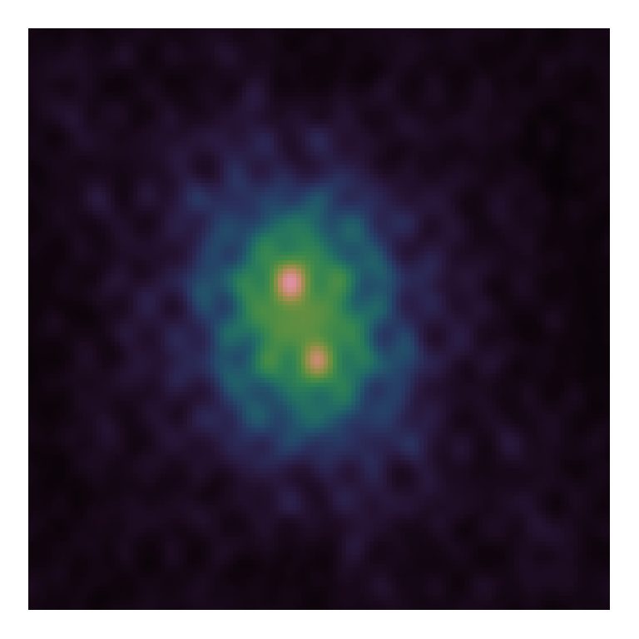

CLEAN

Slide 9
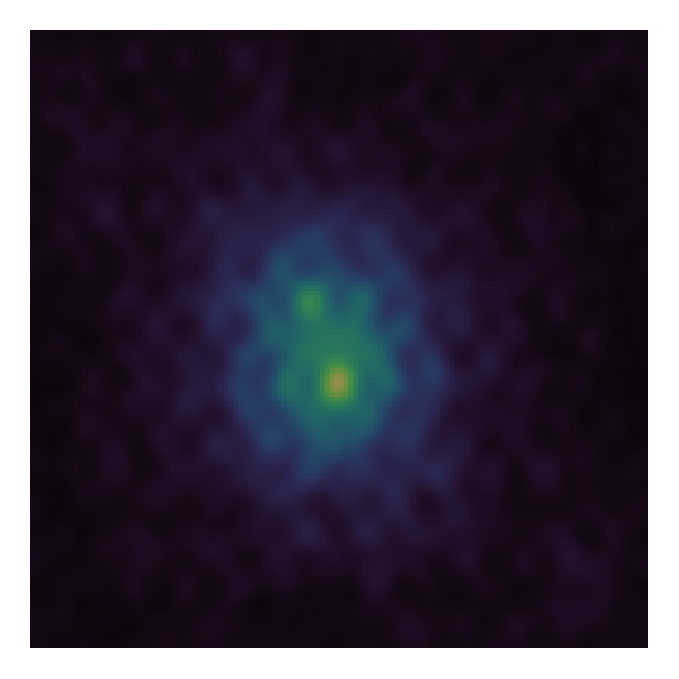
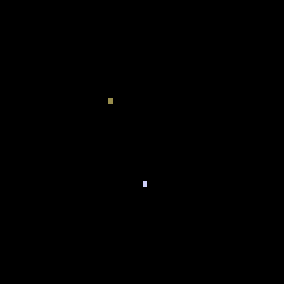
CLEAN

Slide 10
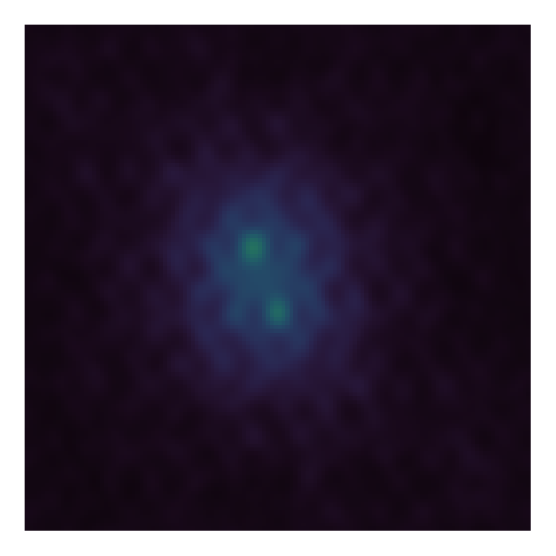
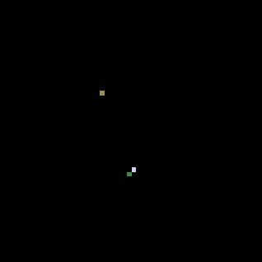
CLEAN

Slide 11
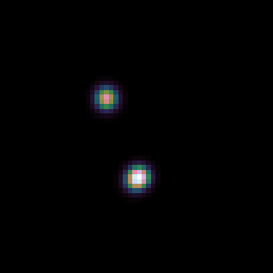
CLEAN

Slide 12
Multi-scale CLEAN

Slide 13
Problems with CLEAN

Slide 14
Elastic Net Regularization

Slide 15
Gradient calculation

Slide 16
Serial Coordinate Descent
Again, show gradients

Slide 17
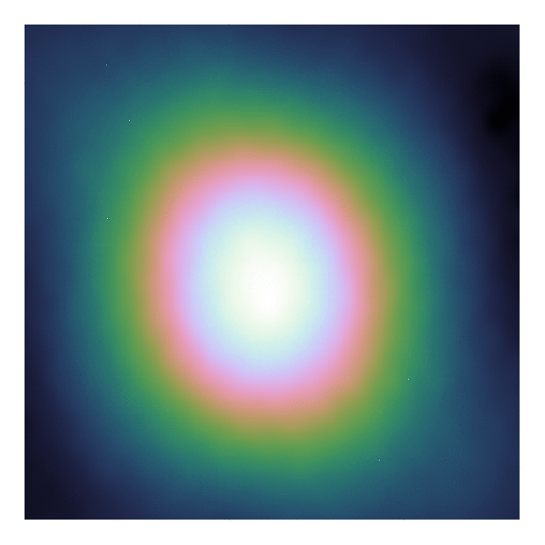

Coordinate Descent

Slide 18
PSF Approximation

Slide 19
Parallel Coordinate Descent

Slide 20
ESO Image

Slide 21
ESO

Slide 22
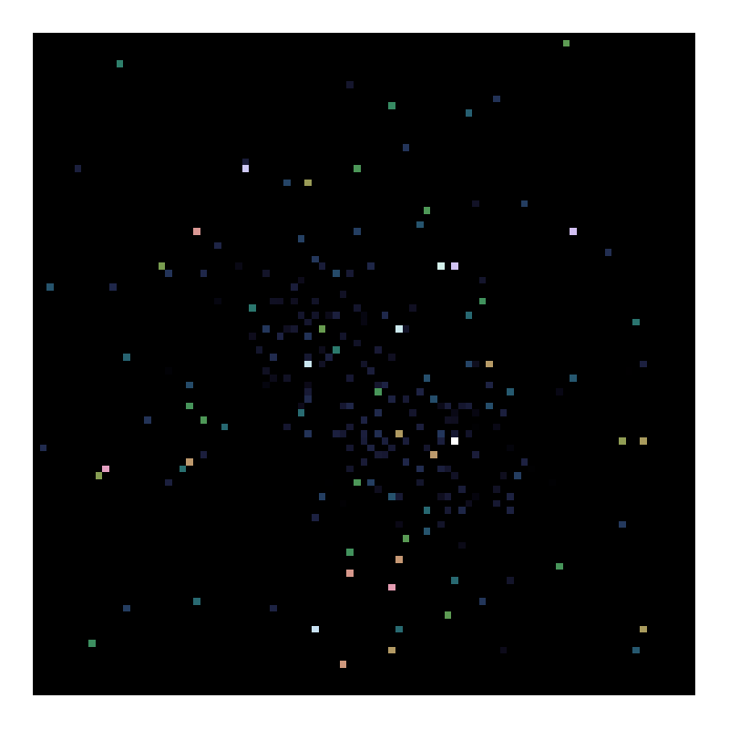
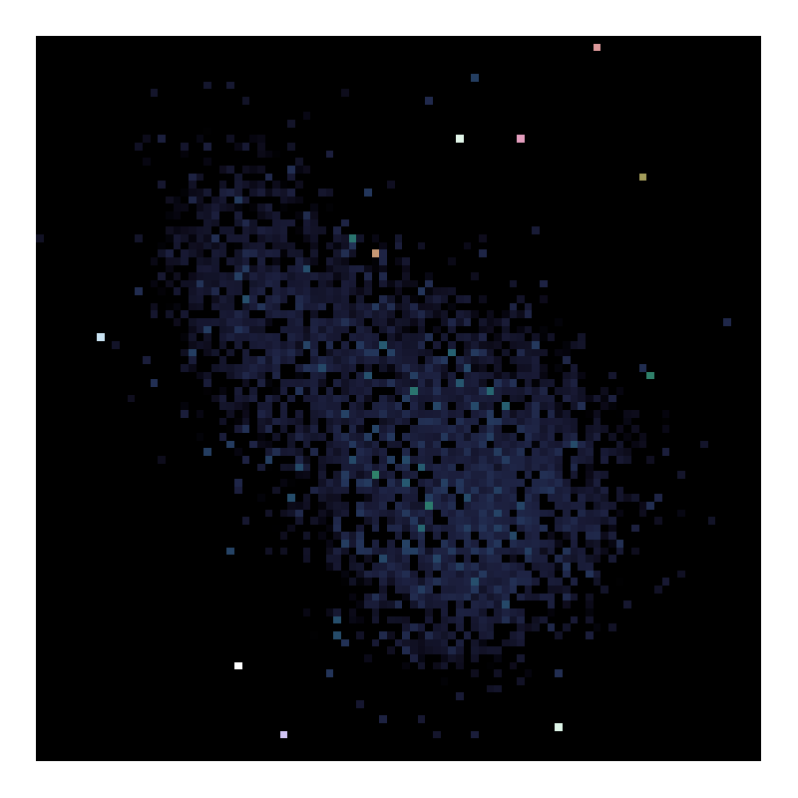
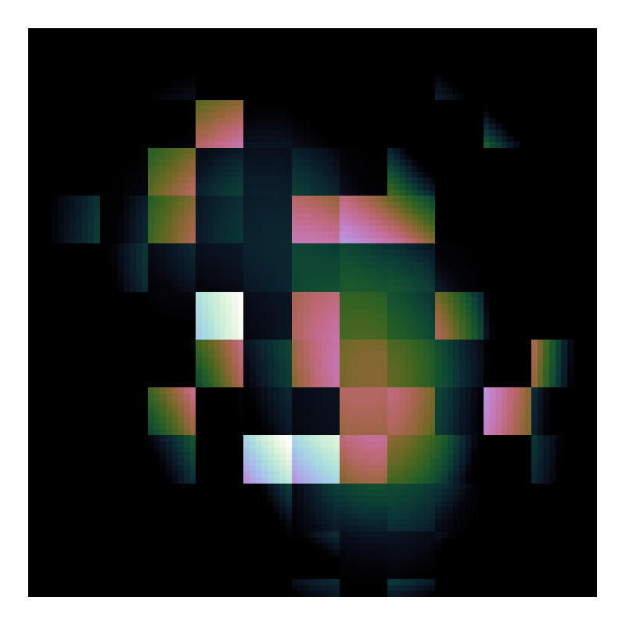
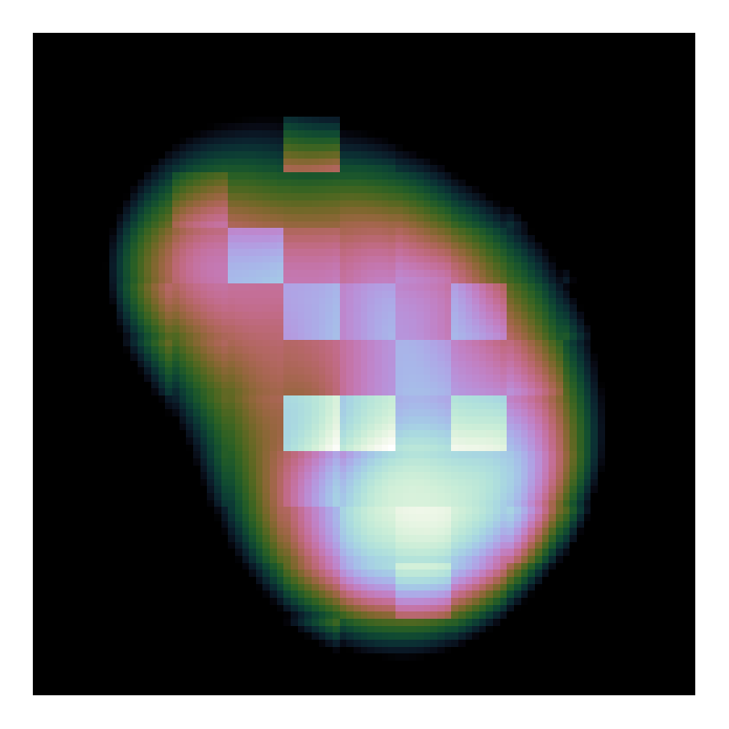
Problems on the deconvolution

Slide 23
Search Factor

Slide 25
LMC Observation

Slide 26
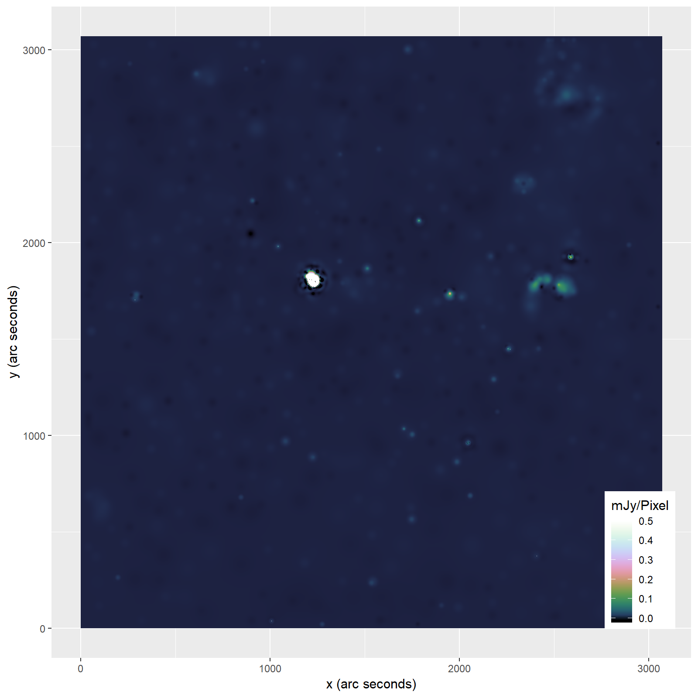

Slide 27
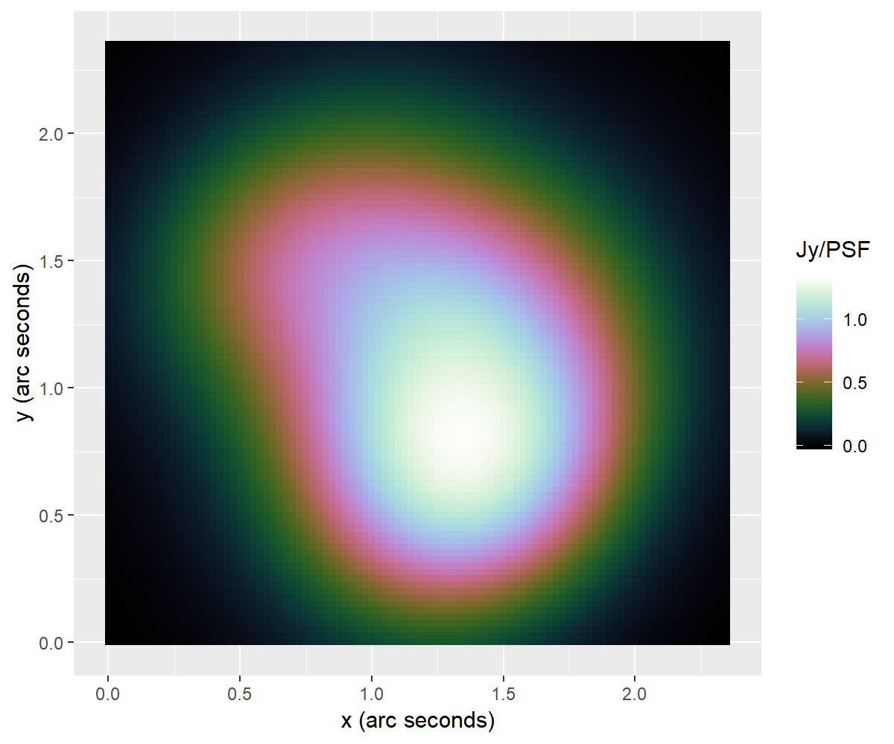
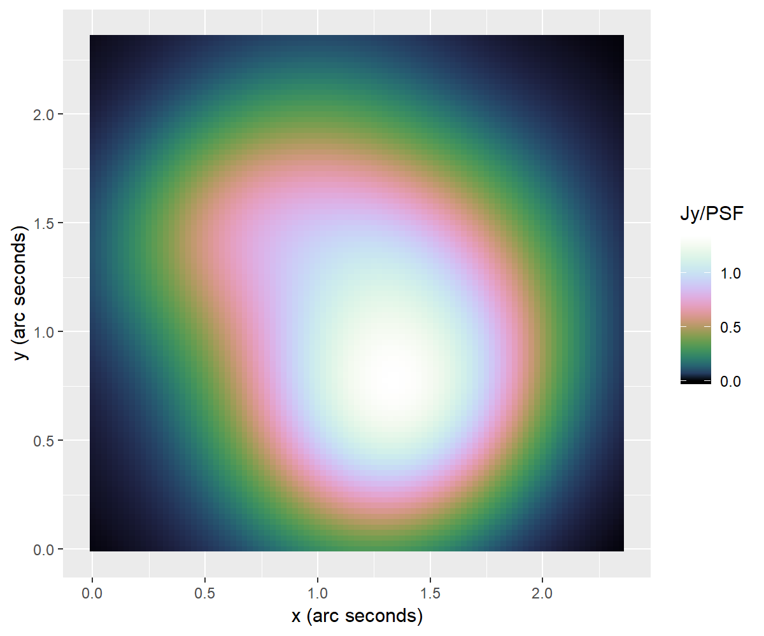
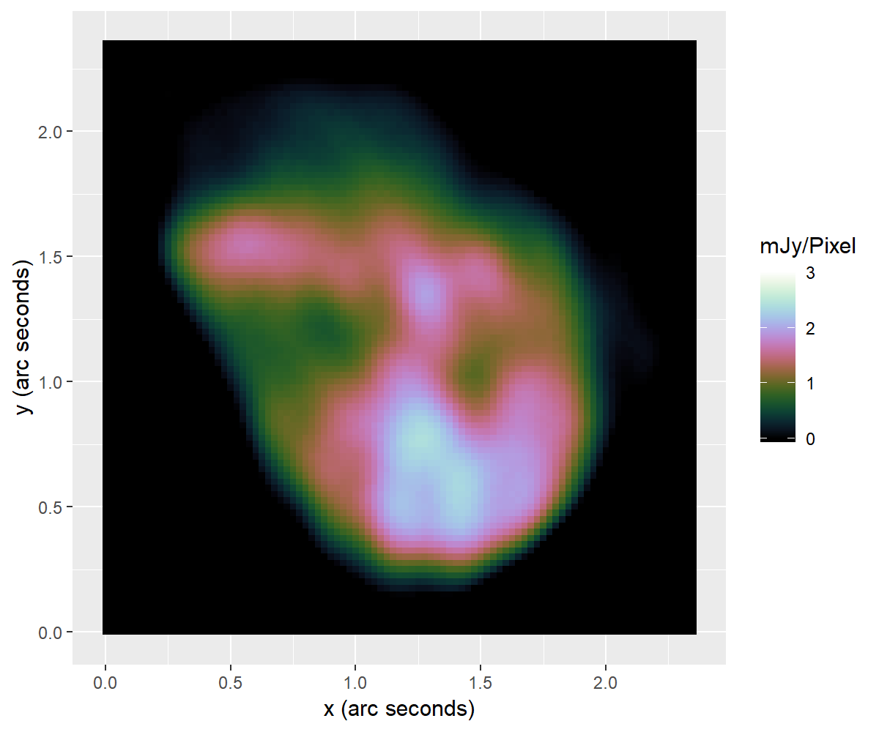
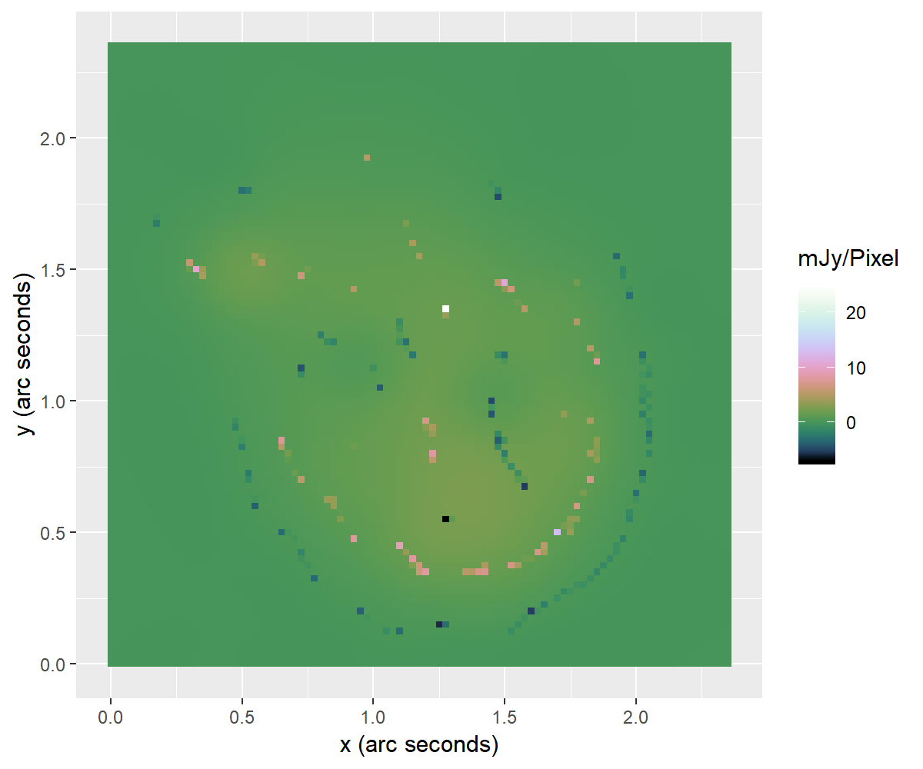

Slide 28
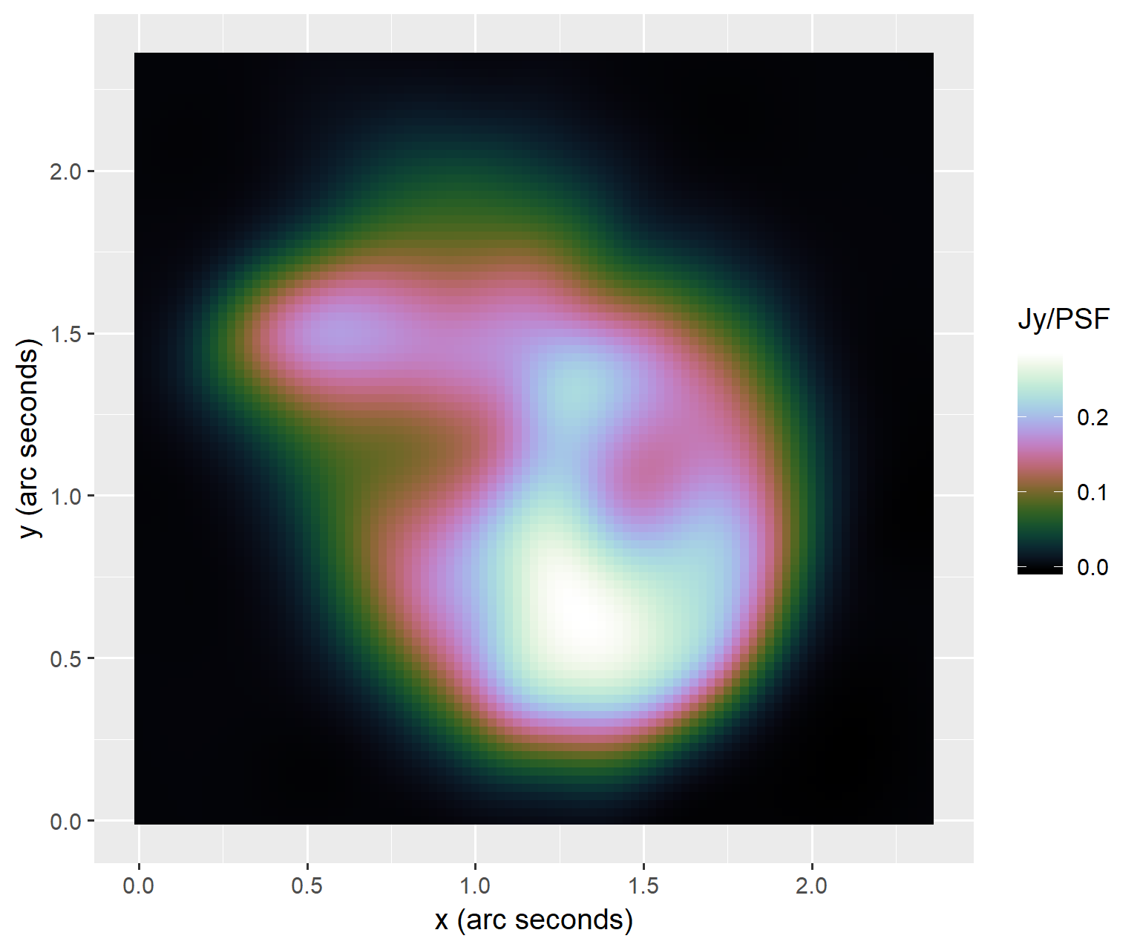

Slide 29
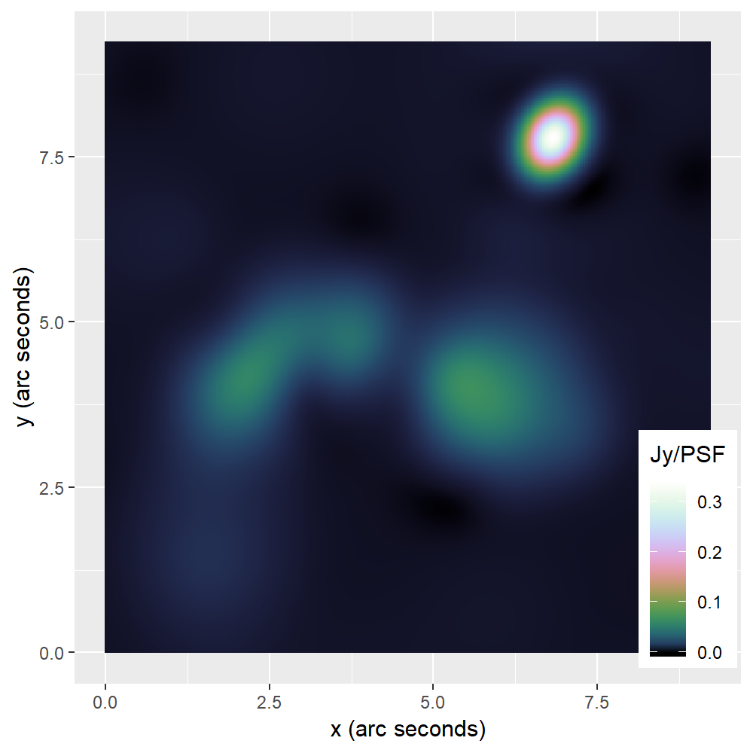
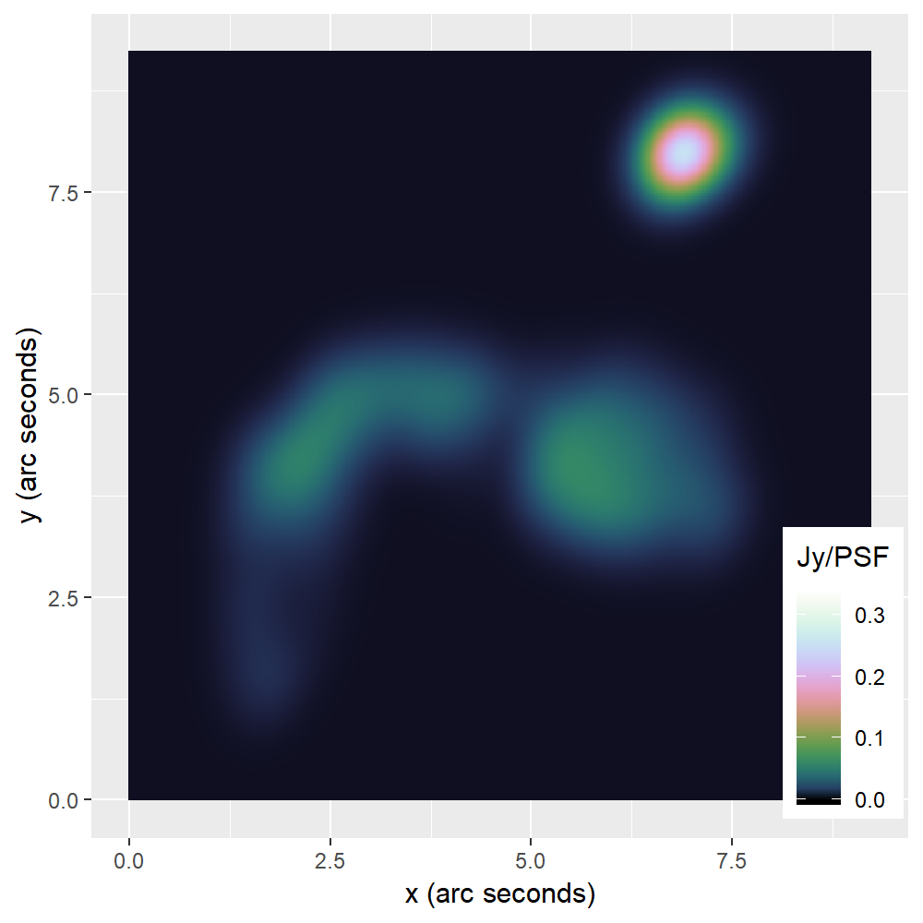
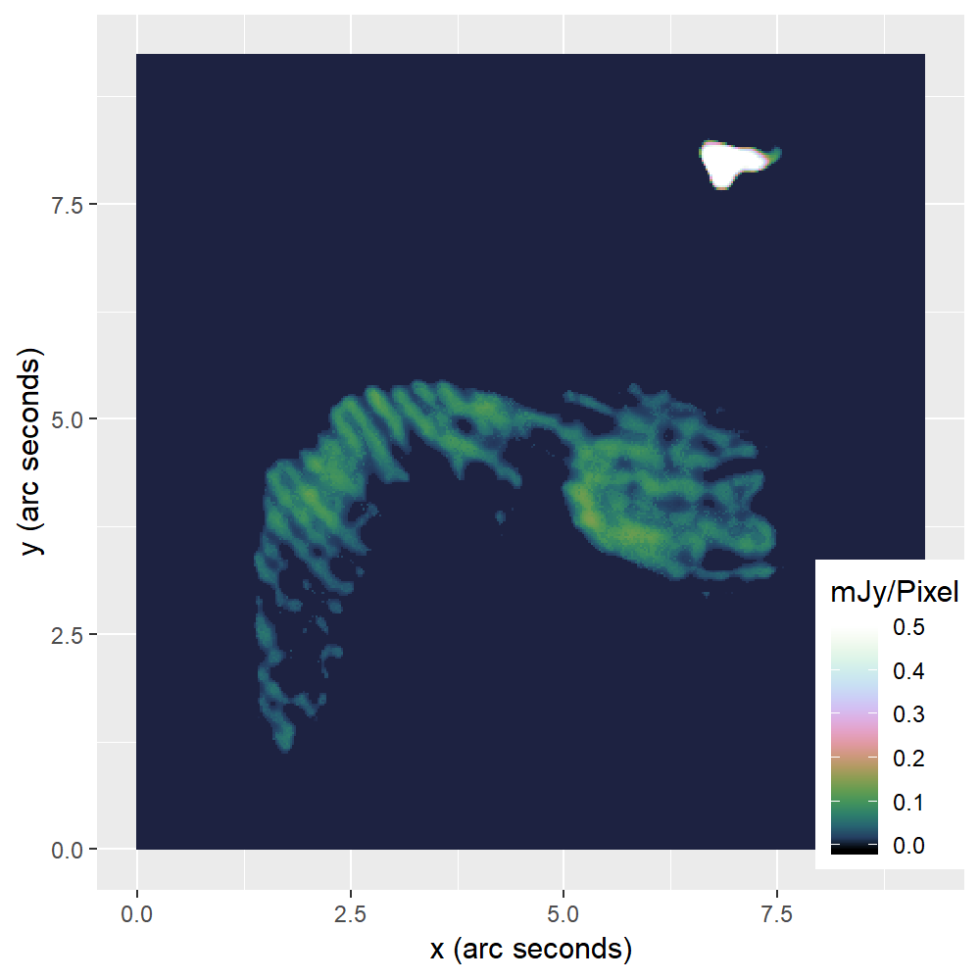
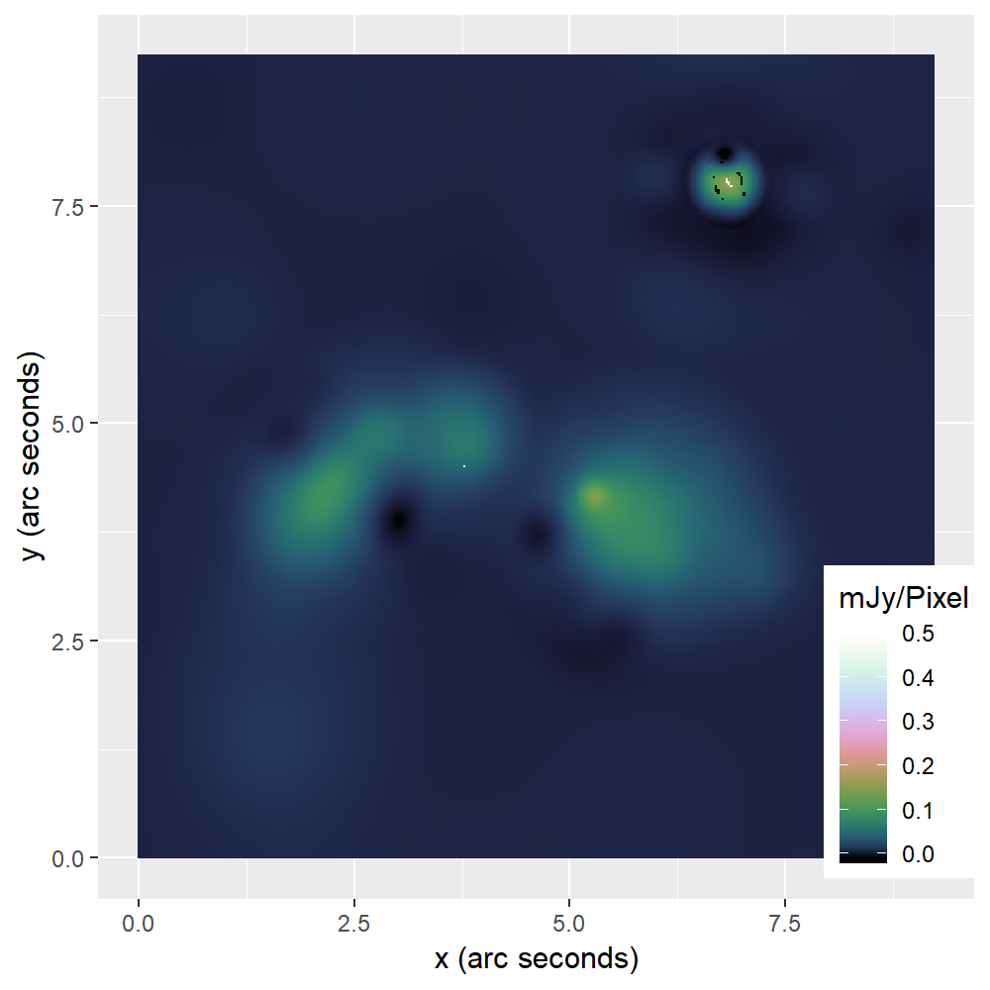

Slide 30
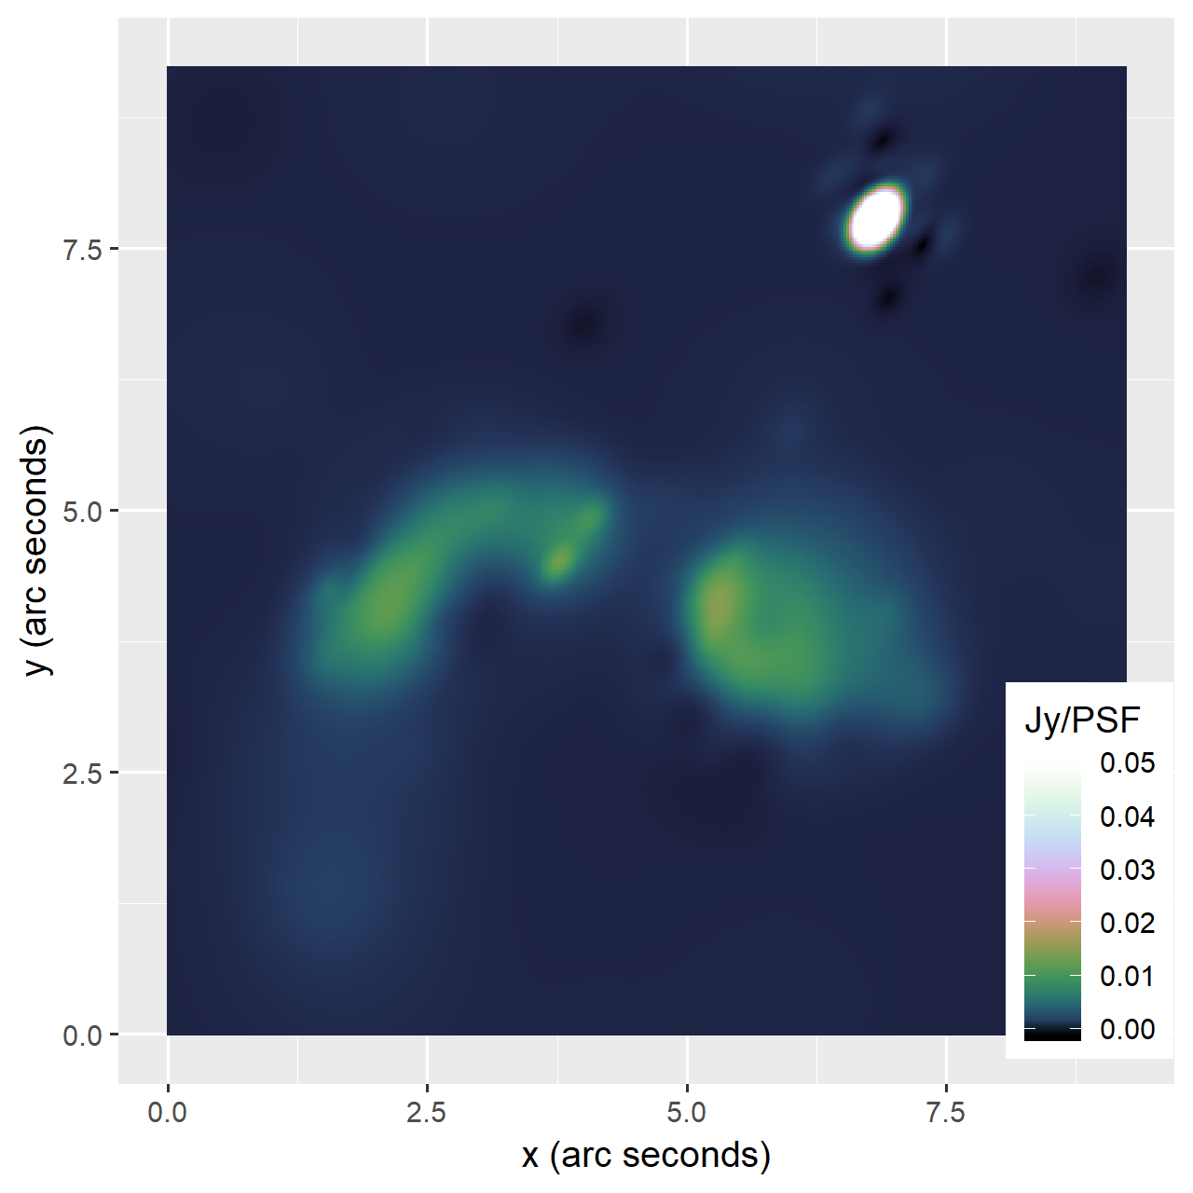

Slide 31
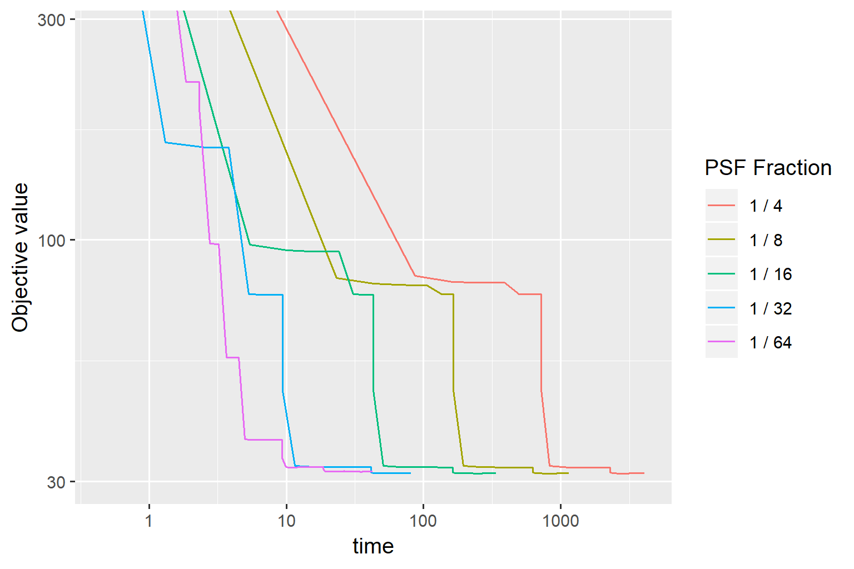
Speedup PCDM

Slide 32
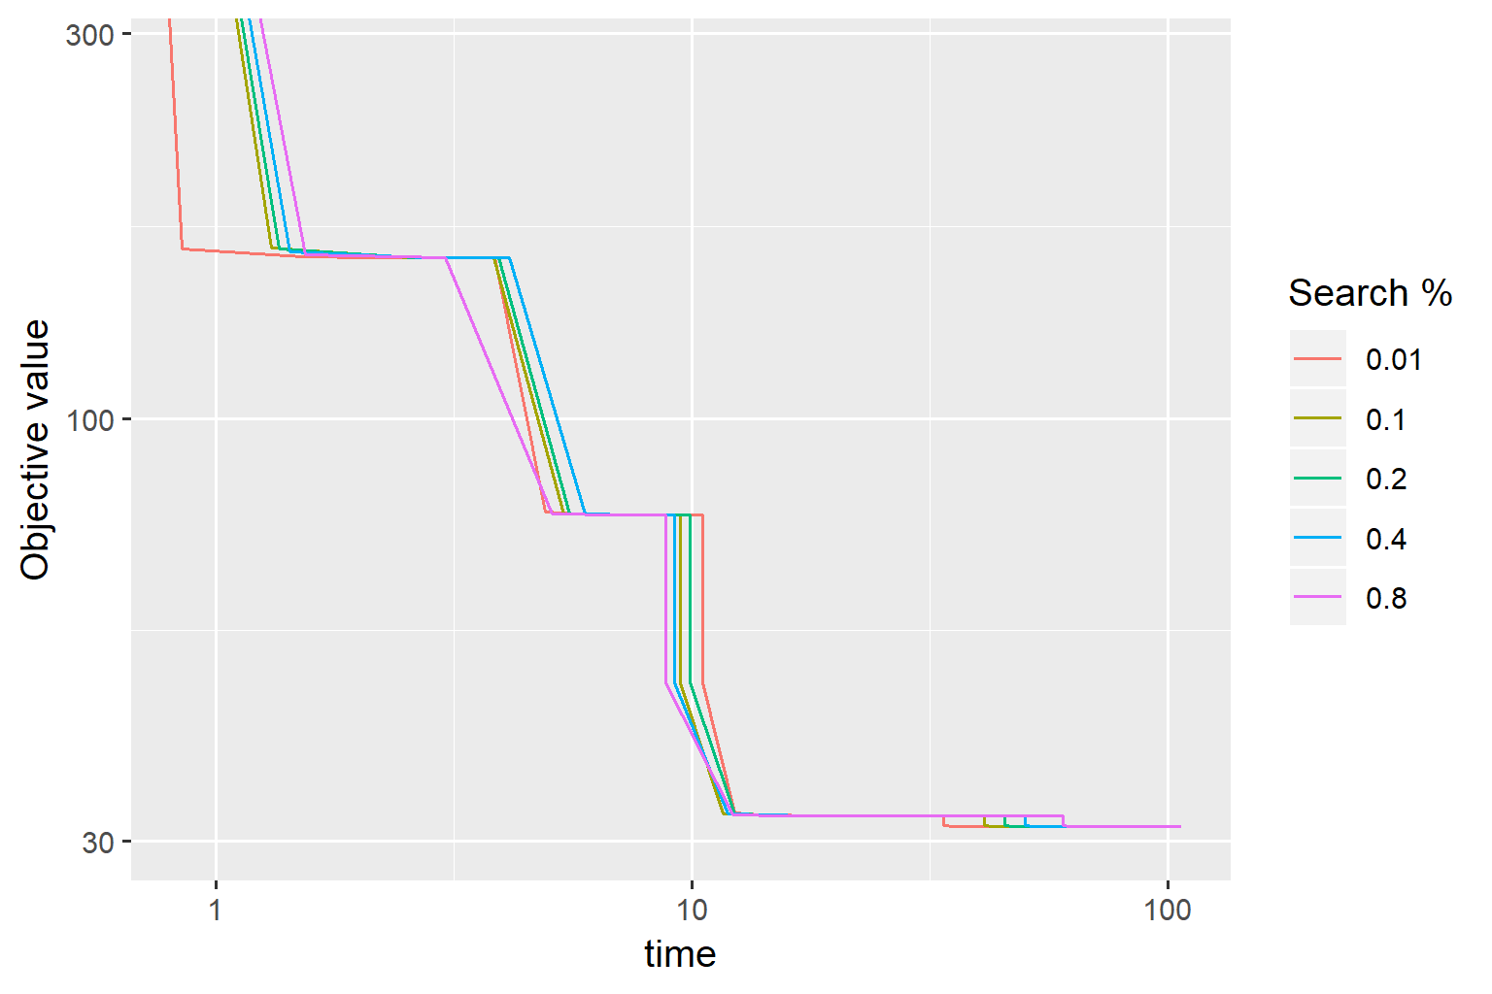

Slide 33
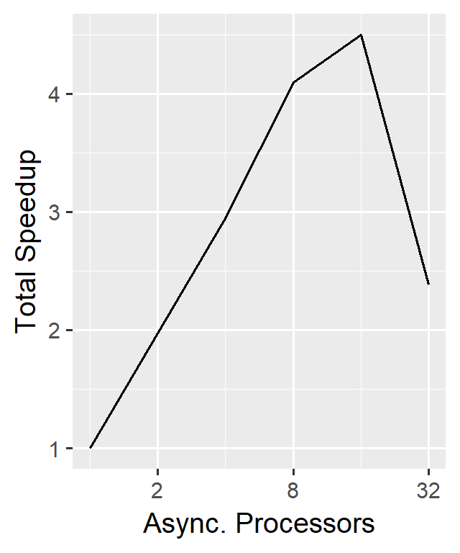
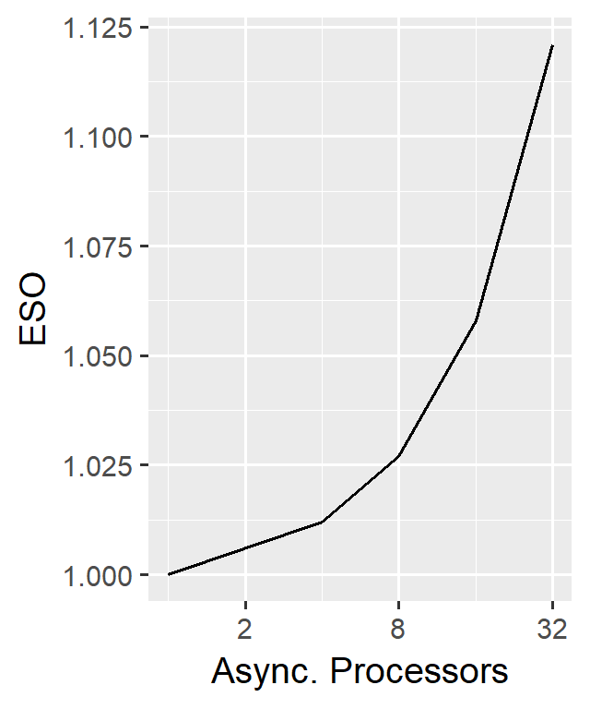
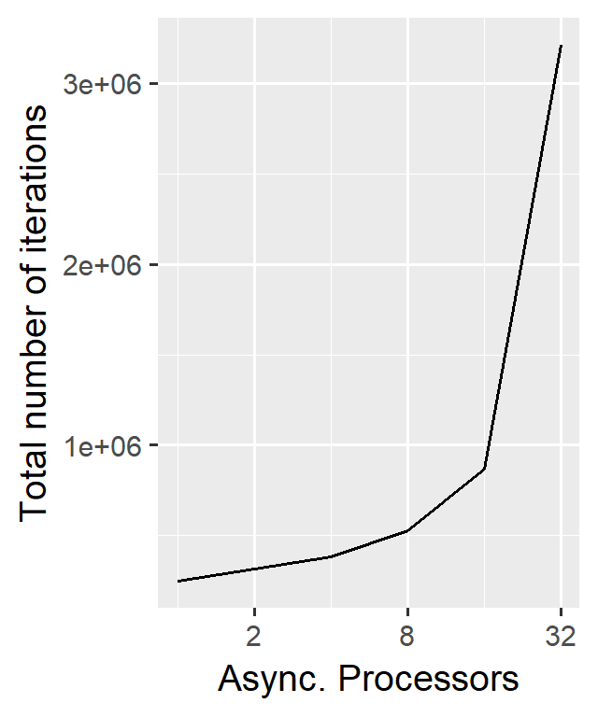
Scalability

Slide 34
Test
Table

Slide 35
Speed comparison to CLEAN

Slide 36
Conclusion
Problem with facets
How much distribution
How useful is elasticnet

Slide 37
Conclusion 2
Fast algorithm. Possible to distribute

